Slide 1
Deep Neural Networks
Getting your matrix
dimensions right

Slide 2
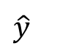
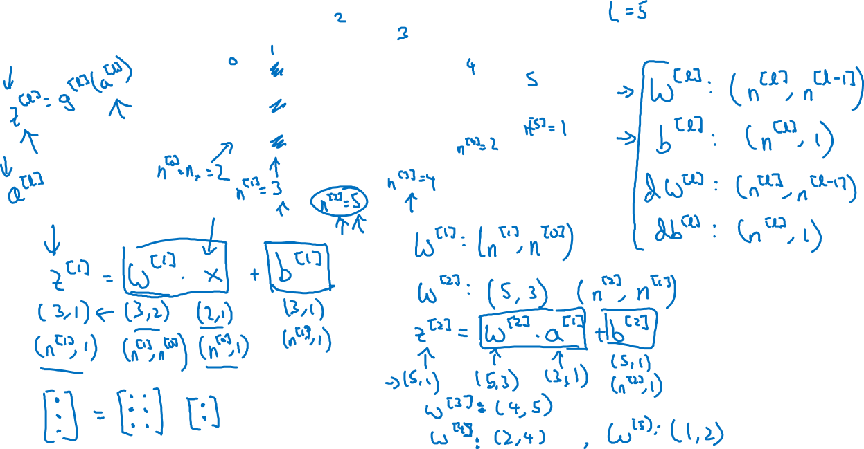

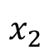
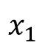
Parameters $W^{[l]}$ and $b^{[l]}$
$$x_{1}$$
$$\hat{y}$$
$$x_{2}$$

Slide 3
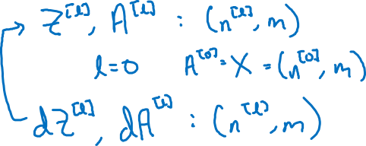
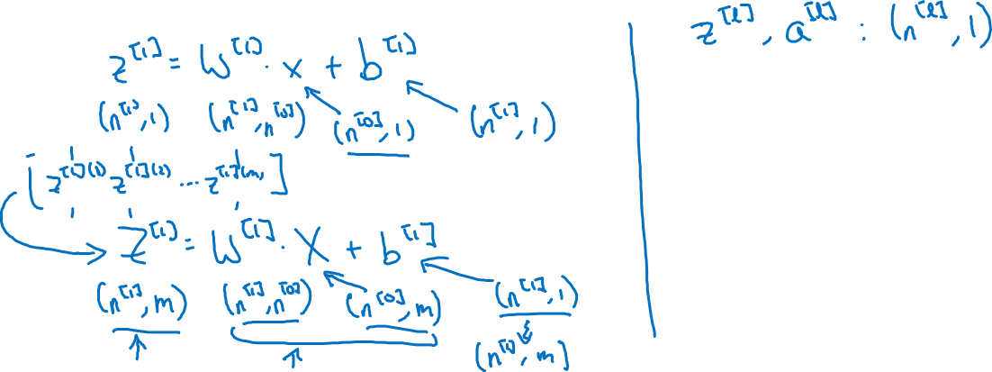
Vectorized implementation
$$x_{1}$$
$$\hat{y}$$
$$x_{2}$$

Slide 4
Deep Neural Networks
Why deep
representations?

Slide 5

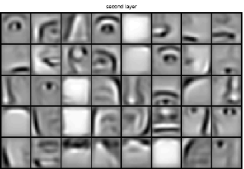
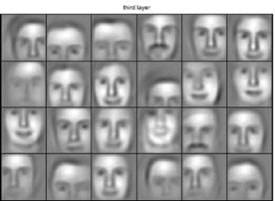
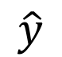
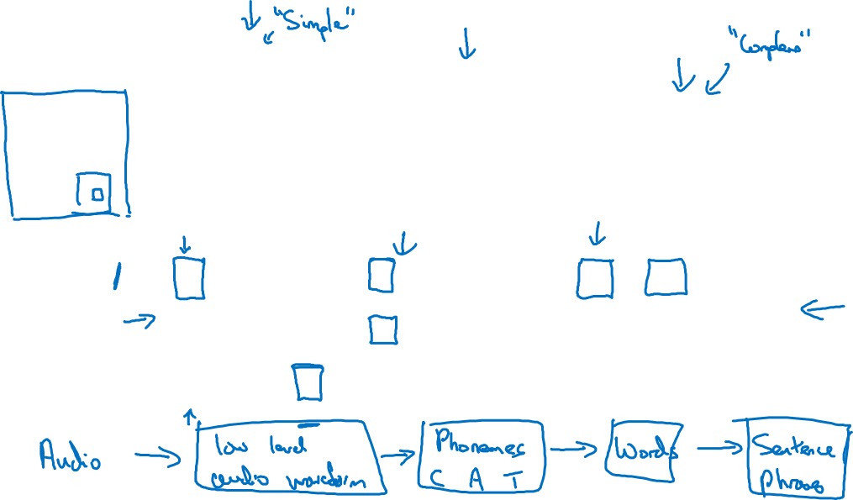
Intuition about deep representation
$$\hat{y}$$

Slide 6
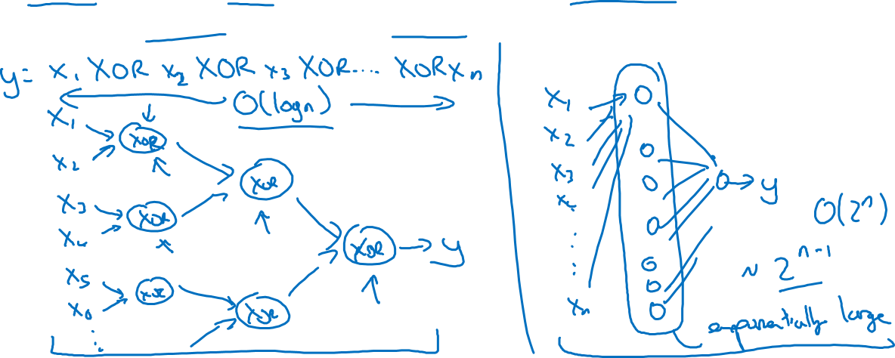
Circuit theory and deep learning
Informally: There are functions you can compute with a “small” L-layer deep neural network that shallower networks require exponentially more hidden units to compute.

Slide 7
Deep Neural Networks
Building blocks of
deep neural networks

Slide 8
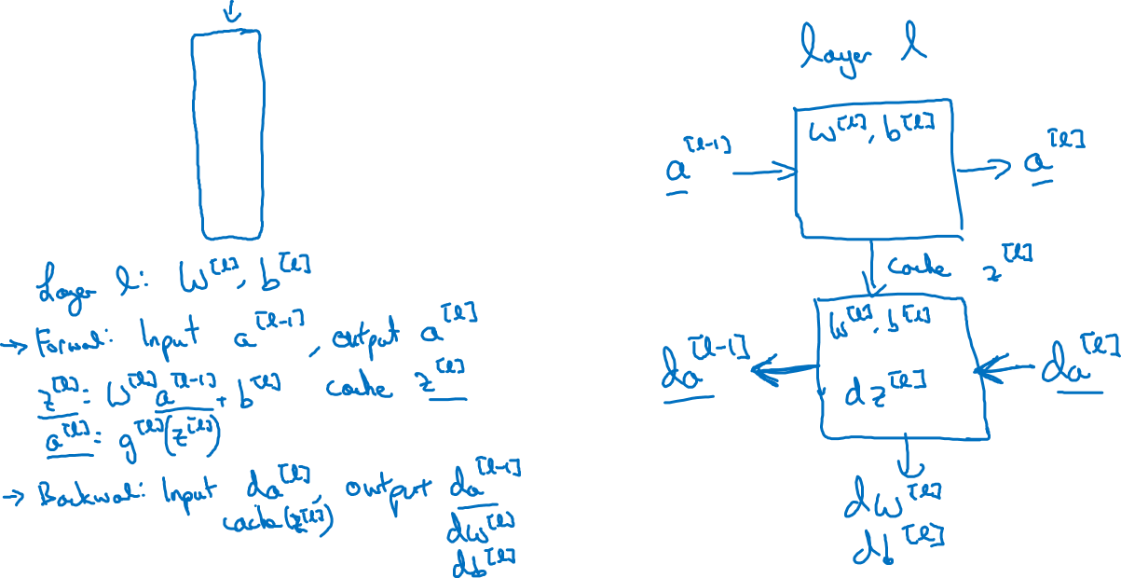
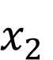
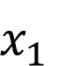
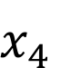
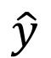

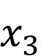
Forward and backward functions
$$x_{1}$$
$$x_{2}$$
$$\hat{y}$$
$$x_{3}$$
$$x_{4}$$

Slide 9
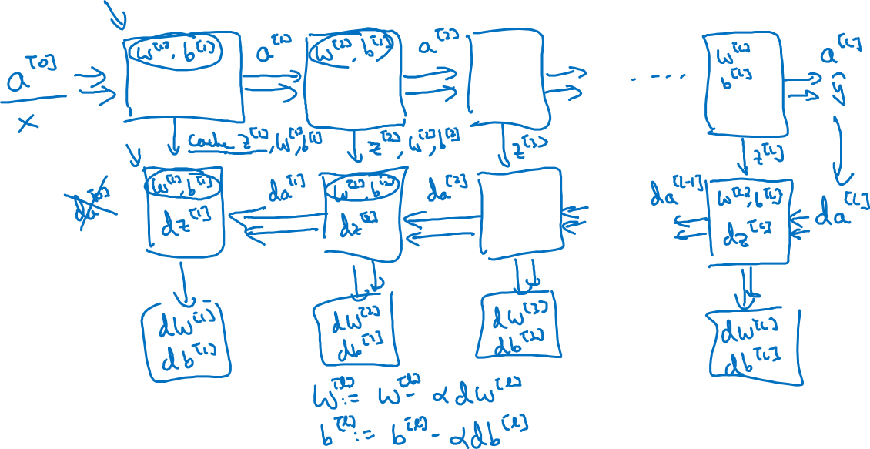
Forward and backward functions

Slide 10
Deep Neural Networks
Forward and backward
propagation

Slide 11
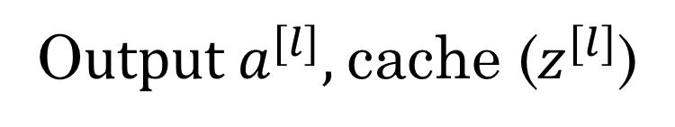
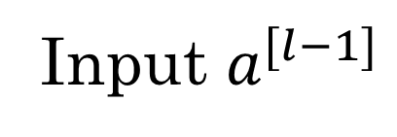
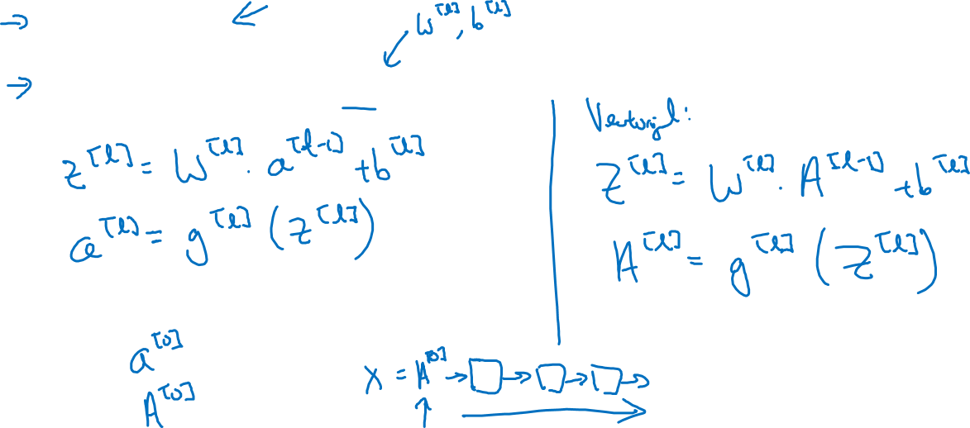
Forward propagation for layer l
Input $a^{[l−1]}$
O$utput a^{[l]},$cache ($z^{[l]}$)

Slide 12
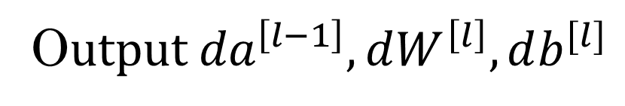
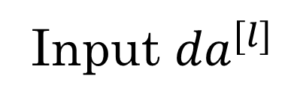
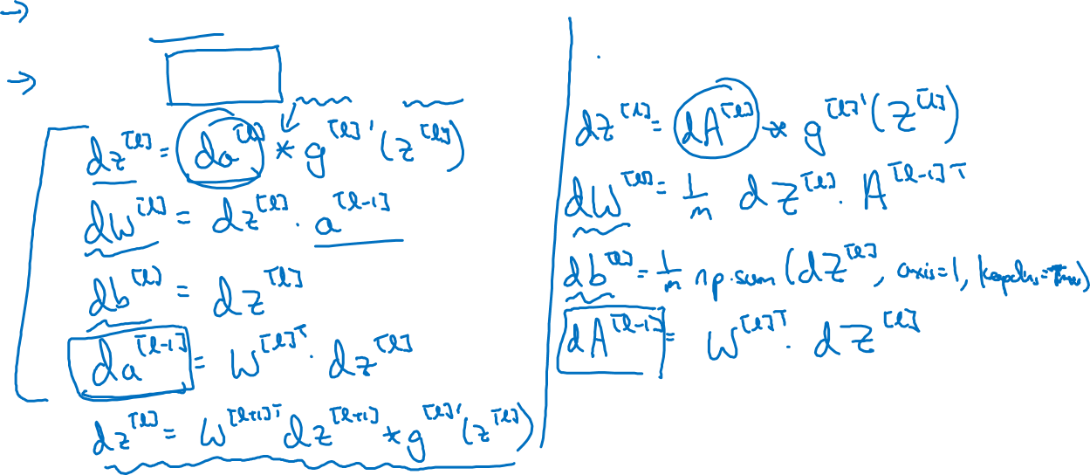
Backward propagation for layer l
Input ${da}^{[l]}$
O$utput {da}^{\left[l−1\right]},dW^{\left[l\right]},db^{[l]}$

Slide 13
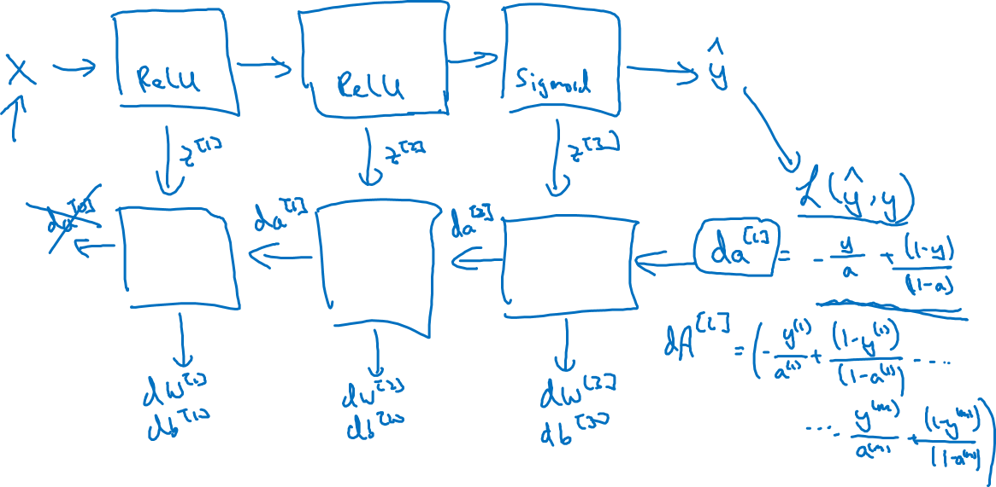
Summary

Slide 14
Deep Neural Networks
Parameters vs
Hyperparameters

Slide 15
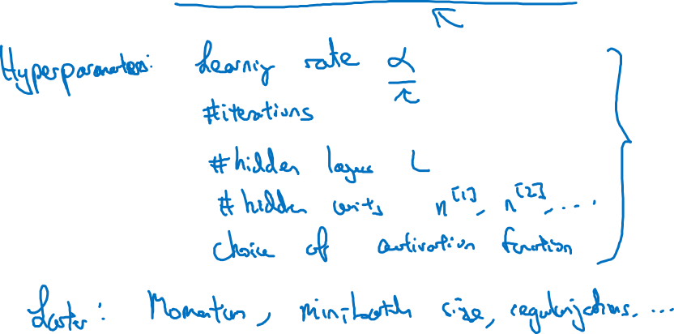
What are hyperparameters?
Parameters: $W^{\left[1\right]} ,{ b}^{\left[1\right] }, W^{\left[2\right]} ,b^{\left[2\right] },W^{\left[3\right] }, b^{\left[3\right] }…$

Slide 16

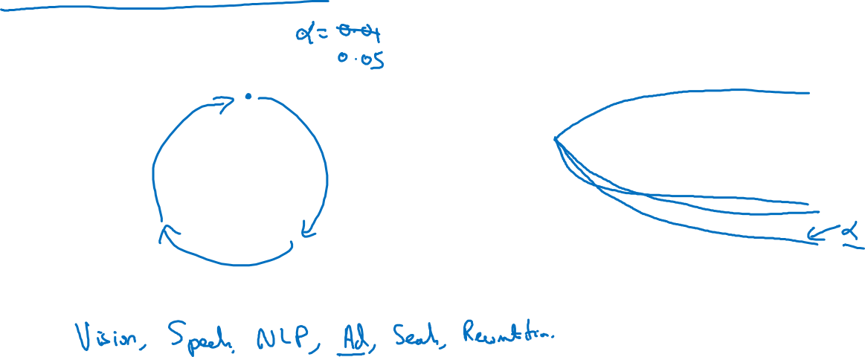
Applied deep learning is a very empirical process
Idea
cost $J$
Experiment
Code
# of iterations

Slide 17
Deep Neural Networks
What does this
have to do with
the brain?

Slide 18
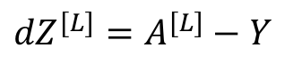
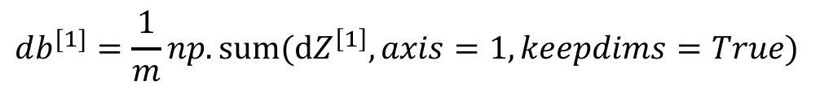
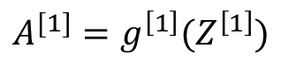
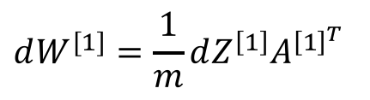
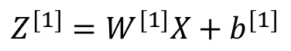
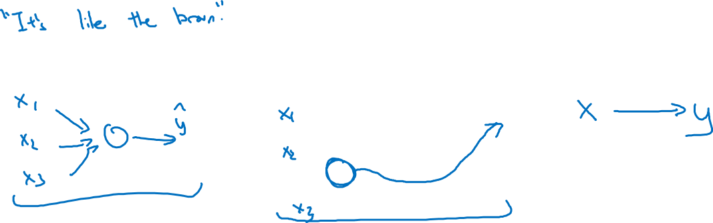
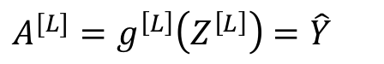
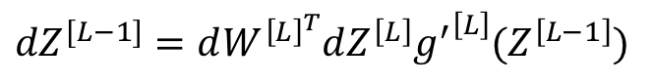
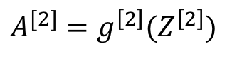
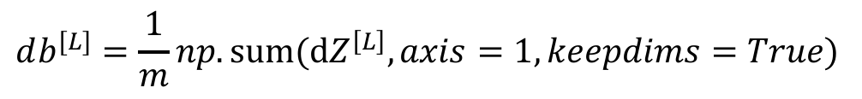
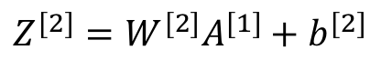
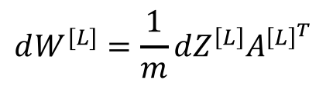
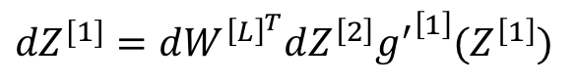
Forward and backward propagation
For example the first activation functions could be ReLU and the last one
Could be sigmoid
$$Z^{[1]}=W^{[1]}X+b^{[1]}$$
$${dZ}^{[L]}=A^{[L]}−Y$$
$$A^{[1]}=g^{\left[1\right]}(Z^{\left[1\right]})$$
$$dW^{[L]}=\frac{1}{m}dZ^{\left[L\right]}A^{{\left[L\right]}^{T}}$$
$$Z^{[2]}=W^{[2]}A^{[1]}+b^{[2]}$$
$$db^{[L]}=\frac{1}{m}np. sum(dZ^{\left[L\right]},axis=1, keepdims=True)$$
$$A^{[2]}=g^{\left[2\right]}(Z^{\left[2\right]})$$
…
$${dZ}^{[L−1]}=dW^{{\left[L\right]}^{T}}dZ^{\left[L\right]}{g^{′}}^{\left[L\right]}(Z^{\left[L−1\right]})$$
$$A^{[L]}=g^{\left[L\right]}\left(Z^{\left[L\right]}\right)=\hat{Y}$$
…
$${dZ}^{[1]}=dW^{{\left[L\right]}^{T}}dZ^{\left[2\right]}{g^{′}}^{\left[1\right]}(Z^{\left[1\right]})$$
$$dW^{[1]}=\frac{1}{m}dZ^{\left[1\right]}A^{{\left[1\right]}^{T}}$$
$$db^{[1]}=\frac{1}{m}np. sum(dZ^{\left[1\right]},axis=1, keepdims=True)$$
Align left/vertical will mess up the equations here

